Slide 1
Roadmap to Success
PRV-101 | First Year Experience Course Fall 2024
Week 2

Slide 2


Welcome and Personal Histories Exercise
Goals:
Builds Connections: Sharing personal stories helps you find common ground, fostering a sense of connection with your peers.
Encourages Openness: When you share aspects of your personal history, it encourages a culture of openness and trust​. ​
Humanizes Us: Learning about each other's backgrounds and experiences helps to humanize your peers, breaking down formal barriers and promoting empathy in the class.
Partner Exercise
Spend 3-5 minutes discussing the questions below in pairs:
Where did you grow up?
Did you have any siblings and if so, where did you fall in that order?
What is something you are most proud of?

Slide 3
Today's Objectives
At the end of this session, students will:
Students will articulate their own definitions of success, both in personal and academic contexts, recognizing how these definitions guide their actions and planning.
Students will begin to demonstrate the ability to set specific, measurable, achievable, relevant, and time-bound (SMART) goals that align with their definitions of success.
Students will identify and apply effective communication strategies for interacting with peers, faculty, and staff to enhance their academic and personal journey.
Notes:
Skip in person

Slide 4
Roadmap to Success
Together, these elements create a robust framework for college success. They encourage proactive planning and engagement, which are essential for navigating the challenges and opportunities of college life
Establish a Vision (What You Want to Achieve)
Identify Your Goals (What Do You Need to Do)
Communicate with Stakeholders (Who Can Help You)
Follow Through (How Will You Do It)

Slide 5
Why Defining Success Matters
Goal Setting and Direction: Having a clear definition of success helps you set realistic and meaningful goals. It provides a direction and purpose as you begin your college journey.
Personal Motivation and Engagement: Understanding your own values and aspirations helps you make informed choices about courses, extracurricular activities, and social engagements, leading to a more fulfilling college experience.
Stress Management and Well-being: College can be a significant transition period, often accompanied by stress and anxiety. Knowing what success looks like can help mitigate these feelings by reducing uncertainty.
Academic and Career Preparedness: Defining success can influence your academic persistence and career preparedness. It encourages you to develop skills and seek experiences that align with your personal and professional goals.
Adaptability: As you progress through your first year, your understanding of success may evolve. Having initially defined what success means helps you reassess and adapt your goals in response to new learnings and experiences, fostering resilience and flexibility.
Notes:
Hide in presentation mode

Slide 6
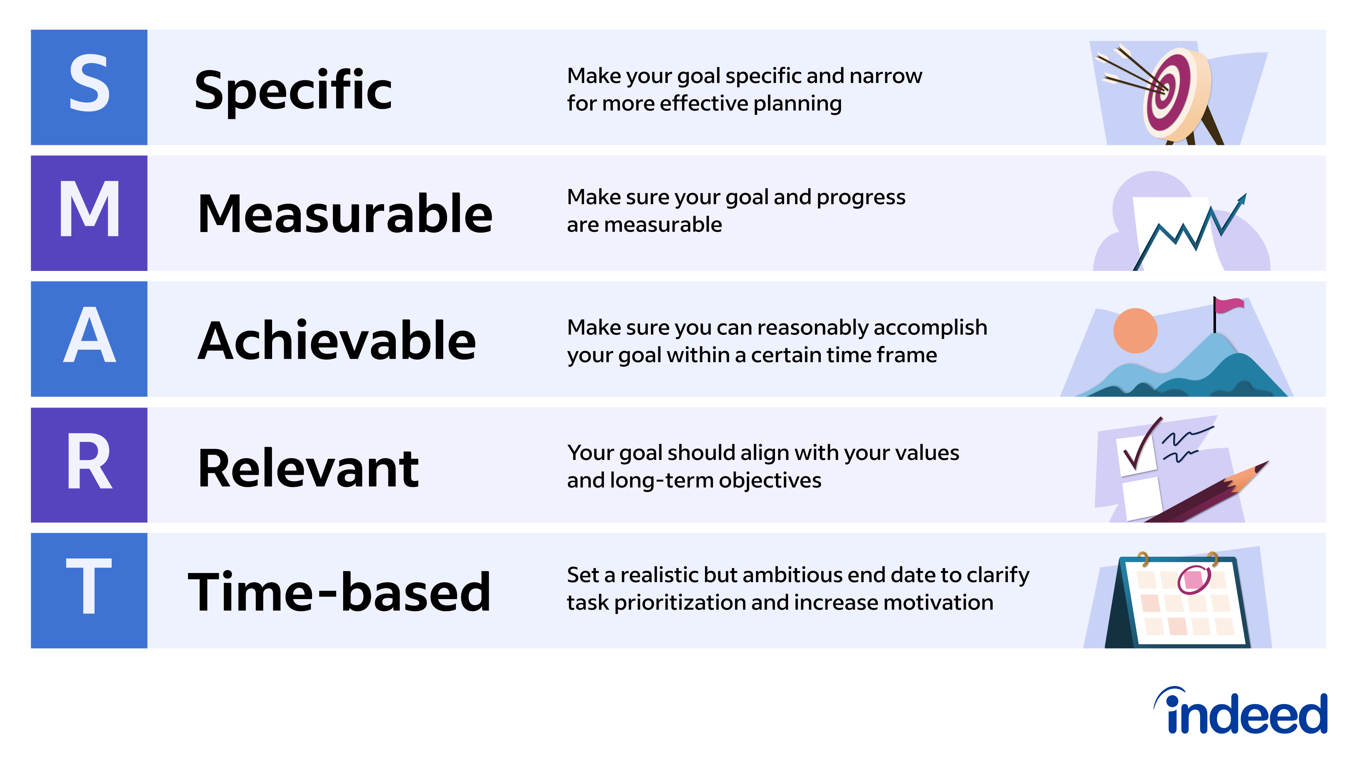
S.M.A.R.T. GOALS

Slide 7




Academic Challenges at Stevens
Increased independence & responsibility; more complex time management
Increased academic demands and pace
Different study strategies for success
Increased expectations from instructors

Slide 8
Tips for Learning in College
Actively participate in class and attend office hours
Connect with your classmates and Teaching Assistants (TAs)
Seek out support early!
Academic Support Center (ASC) Individual & Drop-In Tutoring
Writing & Communications Center (WCC)

Slide 9
Tips for Learning in College
Develop a routine
Wake up and go to bed around the same time every day
Use a calendar/app/reminders for commitments and due dates; work backwards in your calendar to prepare for assignments and exams
Attend lectures, recitations, and review sessions
Create a designated workspace
Maintain self-care
Stay organized
Create a folder for each class (physical or electronic)
Read emails daily and keep your documents organized
Don’t get behind!
Develop good sleep habits, eating habits, exercise/body wellness, mental wellness, etc.

Slide 10
Which Advisor do I go to?
Office of Undergraduate Academics
Special enrollment issues such as AP & Transfer Credit, Credit overload or Complex Scheduling problems​
Special Programs such as Reduced Load Program, Academic Support Program, Early Alert System
Academic Advisor
Advice on major curriculum/study plan
Course registration support​
Questions about changing majors ​
Questions about adding a minor
(IN WORKDAY)
Faculty Advisor
Guidance on in-depth and long-term planning​
Elective courses to take​
Graduate school options​
Career paths
(IN WORKDAY BY EARLY OCTOBER)
Notes:
Eve will do!

Slide 11
Additional Support
Student Success Coach
Staff Facilitator from your FYE class.
Helps you as you navigate campus offices and resources.
Helps you to meet your personal, professional, academic, and social needs and goals.
The 'catch all' for any concerns you have or issues you are facing.
Informal Advisors
Many other informal, unassigned advisors throughout the university on various topics

Slide 12
Reader-Centered Professional Communications

Slide 13

STEP ONE... READ YOUR EMAIL!

Slide 14
Reader-Centric Email Strategies
Know whom you are addressing.
Find the right person or ask them to point you elsewhere
Use the appropriate salutation for their job title and rank
Faculty member: “Professor Cobsnopes”
Dean, Associate Dean, Assistant Dean: “Dean Barnswallow”
Staff Member with Doctorate: “Dr. Queelander”
Staff Member with Title: “Asst. Director Shmantz”
None of the above: “Mr. Kelso” / “Ms. Flendrallt”
Err on the side of formality.

Slide 15
Reader-Centric E-mail (continued)
Provide relevant information so they know who you are
Course number, major, section
Be specific and clear about what you need them to do. Make it easy for them.
Use a clear and specific subject line.
Clarify the important information / request up front – then provide detail
Give basic background info on the issue – what steps have you already taken?
Consider the element of time.
Make it easy for them to respond right away, before they can forget.
Conclude with a timeline for completion / response / follow-up.
Notes:
"Email is for confirmation; not conversation"

Slide 16
Some Common E-mail Pitfalls
Accidentally hitting “reply-all”
Be careful with “reply all.” And don’t say anything insulting in an e-mail.
TMI
“I was skydiving / having stomach problems / visiting boyfriend”
Mis-gendering the recipient
Look them up! When in doubt, use a non-gendered title if possible
Including private or incendiary material in e-mails
Don’t put it in e-mail if you wouldn’t want it read by your grandparents or the FBI
Asserting a request or demand that is unreasonable
“Please change my grade because I need my scholarship”

Slide 17
More Common E-mail Pitfalls
Lack of salutation or inappropriate salutation
“Hello,” / “Good morning,” / “Hi, Prof.” / “Mrs. Streaser,”
Failure to provide necessary information for the reader
Course number, section, year, etc.
Lack of attention to stated policies / procedures (esp. syllabus)
Failure to specify a request
Notes:
Eric – work on a bad one or two; replace some of the wordy stuff with this

Slide 18
Help Sparky Write a Better Email!
Subject: SOS: I’m Lost Without the Reading & Slides! 🙈
From: sparkym@stevens.edu
To: prof.smith@stevens.edu
Date: September 3, 2024, 11:42 AM
I hope you’re having an awesome day! 🚀 I forgot the reading for our next class and I’m starting to feel like a lost puppy. 🐶 Could you help me out with a quick summary or key points? Also, I’m having a scavenger hunt trying to find the lecture slides. Any chance you could share them or point me in the right direction?
Thanks a ton for saving me from academic doom. 😅 I can’t make it to office hours this week but I’m just a click away on email. You’re the best!
Sparky

Slide 19
Missing Class Examples
To: Prof. Doe
From: Sparky McDaniels
RE: MGT 300 Section A, Missing Class
Dear Professor Doe,
I am a student in the above-mentioned section of Business Communication. Unfortunately, I am going to have to miss class today because I’m not well. I realize that today is peer review for Assignment 2. I was wondering if I could peer review the assignment separately with a friend, or seek feedback from the WCC. Please let me know when you get a chance, and thanks,
Sparky

Slide 20
Need an Extension
To: Prof. Doe
From: Sparky McDaniels
RE: MGT 300 Section A, Extension Request
Dear Professor Doe,
I am a student in the above-mentioned Business Communication class. You might recall that I missed class last week because of an illness. Although I’m doing much better, I am a little behind on Essay 2. I was wondering if I could have until Friday to turn in the assignment. Please let me know if you need any additional information, and thanks for your consideration,
Sparky

Slide 21
Seeking Extra Help
To: Prof. Doe
From: Sparky McDaniels
RE: MGT 300, Section A – Help Request
Dear Professor Doe,
I am a student in the above-mentioned section of MGT 300. I am having trouble with the concept of reader centricity, in Chapter 2. I know you mentioned that your Tuesday office hours are canceled for this week – is there another time I could meet with you to discuss the chapter? I am free on Thursday before 12 pm and Friday between 1 pm and 3 pm, for example. Thank you very much,
Sparky

Slide 22
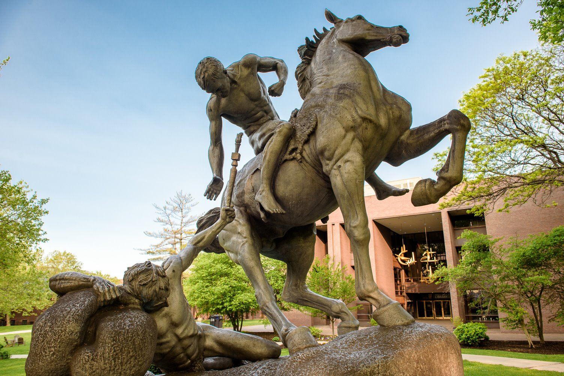
Torchbearer Takeaways
Vision is Crucial: A clear vision acts as a roadmap, guiding you through your college journey. It helps in aligning your actions and decisions towards achieving your personal and academic aspirations.
Goal Setting is Fundamental: Effective goal setting, particularly through SMART goals, is essential for breaking down your vision into achievable steps. It provides clarity and focus, helping you track your progress and stay motivated.
Communication is Key: Successfully navigating college requires proactive communication. Expressing your needs, seeking help when necessary, and maintaining open lines of communication with peers, professors, and advisors are vital for academic success and personal well-being.
Integration and Application: Integrating these elements into daily college life can enhance your overall experience, leading to better outcomes both in academics and in personal development.

Slide 24
Getting Help: Escalating Concerns
With Faculty:
First, try speaking another time with the faculty member
Next, try the Department Chair
Then, try the Associate Dean for Undergraduate Education in the school
Finally, the School Dean
With Staff:
First, try speaking with the staff member another time
Next, try their supervisor or office leadership
Important to Note:
It's best for you to try to get help first before involving your parents
If you are still unsatisfied after all of these efforts, contact a staff member in the Office of the Provost for Academic Concerns or a staff member in the Office of Student Affairs (Vice President, Assistant Vice President, or Dean of Students) to assist and guide you
Not all concerns are going to be resolved to your liking, but we will do our best to support you when possible.
Notes:
Only discuss if there is time – maybe pop it into an Appendix

